Slide 1
Introduction to Visualization
LIHAO WANG

Slide 2
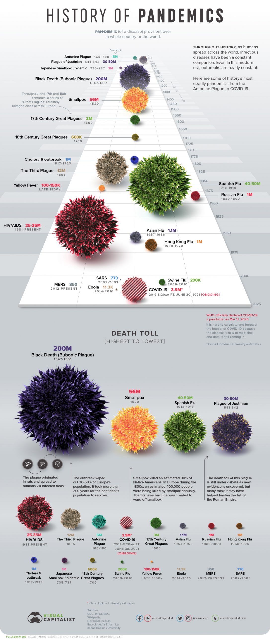
Visualization from visualcapitalist.com

Slide 5
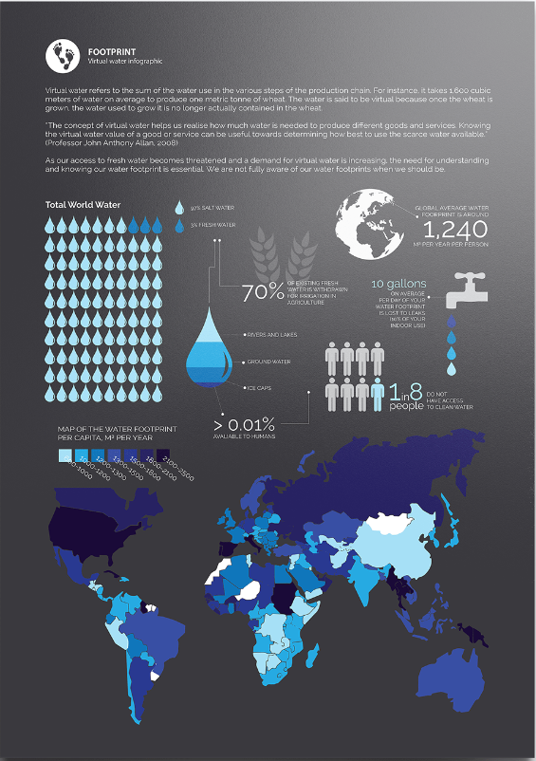
Visualization from behance.net

Slide 6
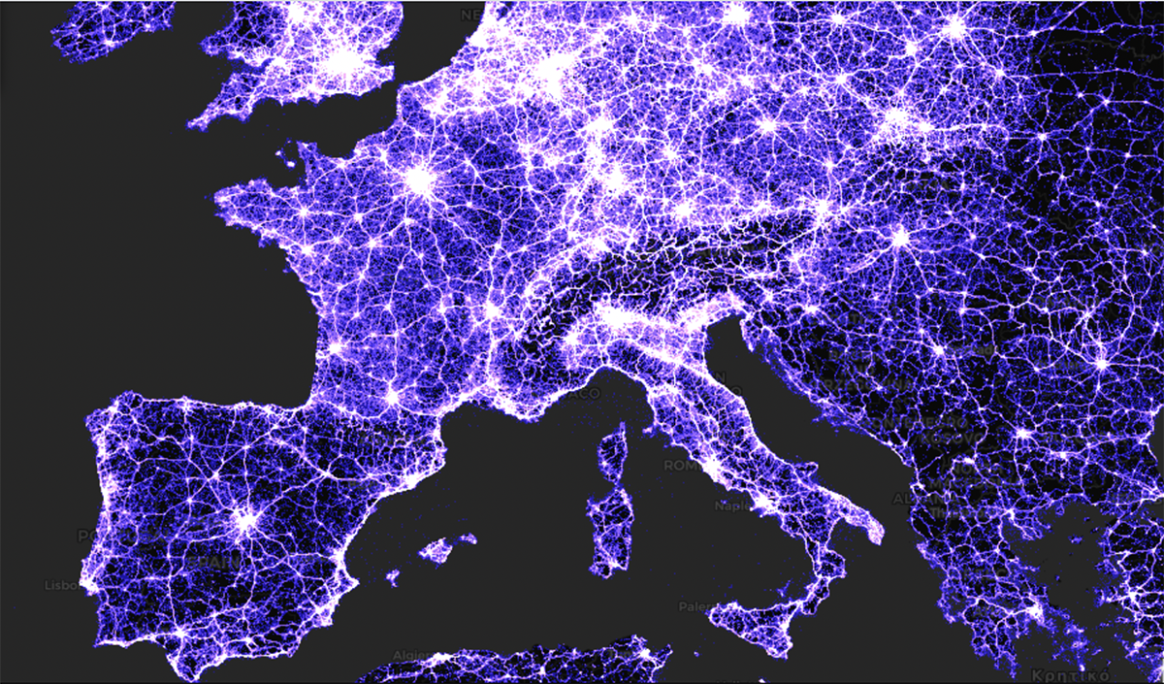
Visualization from alpercinar.com

Slide 7
All Visualization Reference
The Water Footprint Project: www.behance.net/gallery/92084761/Water-Consumption-Data-Viz
Visualizing the History of Pandemics:www.visualcapitalist.com/history-of-pandemics-deadliest/
Cell Towers Map of the World: https://alpercinar.com/open-cell-id/

